Slide 1



Crop yield production
Arjun college of technology
Vasala Vasu Yadav
Batheni Vinay Yadav
ThathiReddy Jyothi Reddy
Paddolkar Harsha Vardhan
Palimkota Yaswanth

Slide 2
Problem Statement
Brief Overview:
As the global population continues to grow, there is an urgent need to increase agricultural productivity to ensure food security for future generations. Crop yield production faces several challenges, including
Key Objectives:
climate changes: Unpredictable weather patterns, droughts, and floods impact crop growth.
Soil degradation: Loss of soil fertility and overuse of land reduces crop productivity.
Limited resources: Water scarcity and limited arable land hinder optimal crop growth.
Pests and Diseases: Crop pests and diseases threaten yield stability and quality.
Technological Gaps: Inadequate access to advanced agricultural technologies in some regions limits efficient production.
Source :
www.freepik.com/

Slide 3
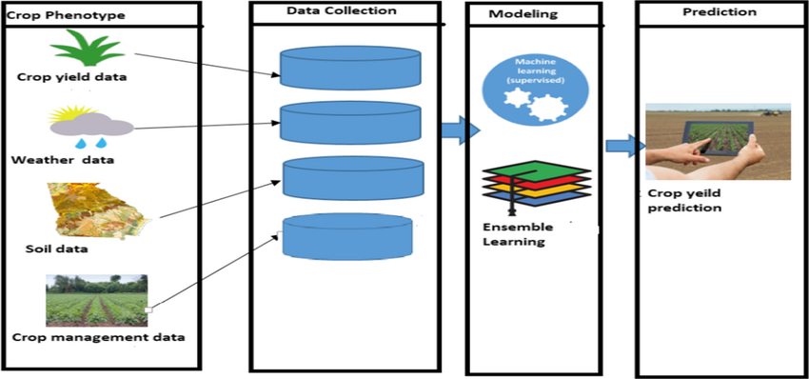
Solution
1. Adoption of Climate-Smart Agriculture (CSA)
2. Soil Health Management
3. Efficient Water Management
4. Integrated Pest Management (IPM)
5. Technology Integration in Agriculture
6. Capacity Building and Education
Source :
www.freepik.com/

Slide 4
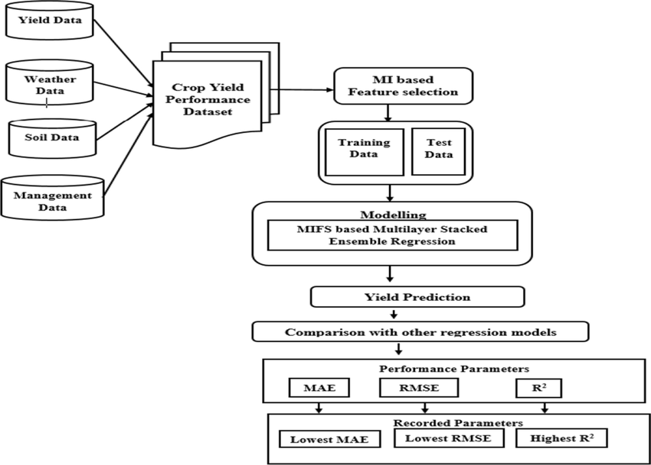
Dataset Overview
The dataset used for analyzing crop yield production contains comprehensive information about agricultural practices, environmental factors, and crop yields. It serves as a valuable resource for understanding the key drivers of crop performance and identifying potential areas for improvement
To analyze the relationship
To identify patterns and trends
To provide insights
Source :
www.freepik.com/

Slide 5
Methodology
Approach:
Step 1: Problem Understanding and Objective Definition
Step 2: Data Collection
Step 3: Data Preprocessing and Cleaning
Step 4: Exploratory Data Analysis (EDA)
Step 5: Model Selection
Step 6: Model Training
Step 7: Model Evaluation
Step 8: Deployment
Step 9: Monitoring and Updating the Model
Algorithms Used:
Linear Regression:Linear regression is one of the simplest supervised learning algorithms, where the relationship between the independent variables (e.g., temperature, rainfall, soil quality) and the dependent variable (crop yield) is modeled as a linear equation.
Source :
www.freepik.com/

Slide 6
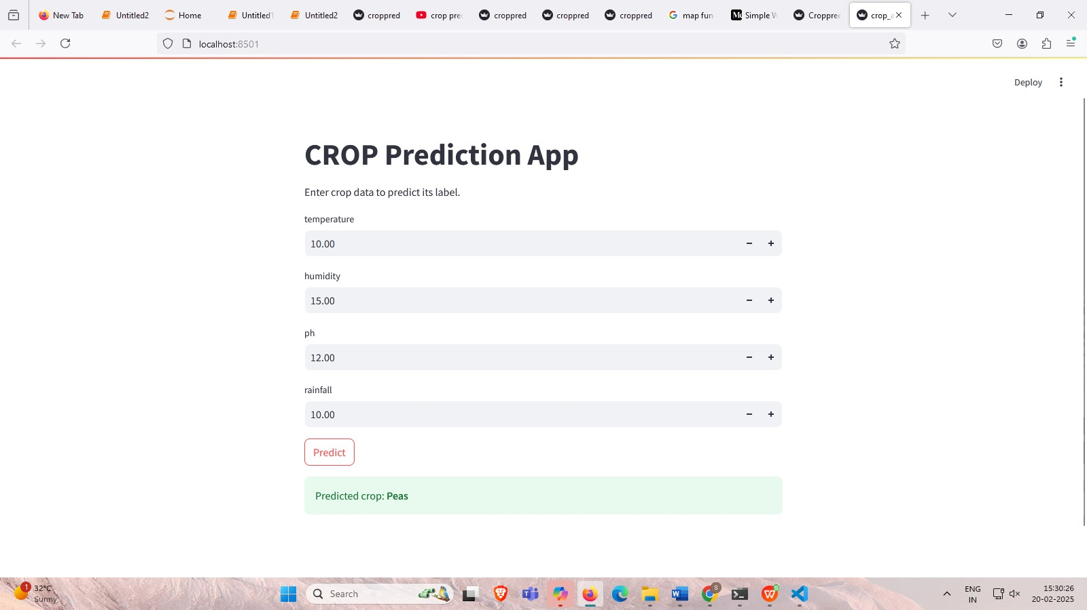
Results
Source :
www.freepik.com/

Slide 7

Conclusion
Summary:
The solution aims to provide farmers with accurate predictions to optimize resources, improve crop management, and enhance overall productivity.
Future Work: There are several areas for improvement and future work to enhance the system’s effectiveness and adapt to evolving agricultural practices. Below areas:
Advanced Machine Learning Techniques
Integration of More Data Sources
Real-Time Adaptation and Continuous Learning
Source :
www.freepik.com/

Slide 8
References
https://www.kaggle.com/datasets/akshatgupta7/crop-yield-in-indian-states-dataset

Slide 9
Thank You
Notes:
Thank You !!

